Slide 1


Design Patterns 102
John Beverley
Assistant Professor, University at Buffalo
Co-Director, National Center for Ontological Research
Affiliate Faculty, Institute of Artificial Intelligence and Data Science

Slide 2
Outline
Design Patterns Guidance
Mermaid
Guardrails
Complex vs Simplified Design Patterns

Slide 3
Outline
Design Patterns Guidance
Mermaid
Guardrails
Complex vs Simplified Design Patterns

Slide 4
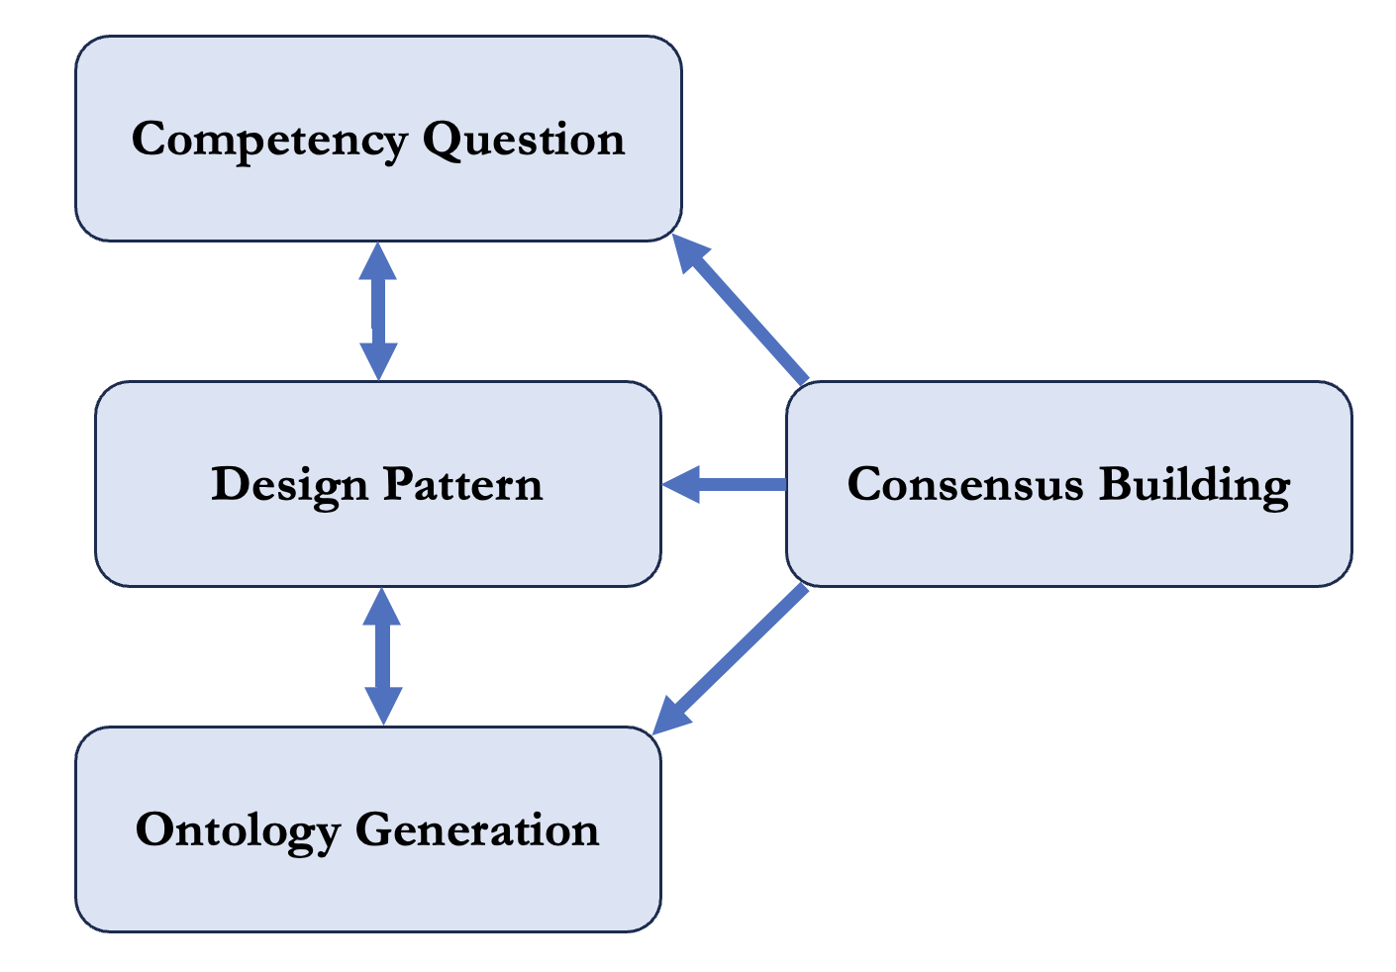
Guidance

Slide 5
Guidance
Identify competency questions

Slide 6
Competency Questions
Competency questions are used to guide ontology development and generate automated checks to ensure answers are sufficient
In our drone tracking example we needed to represent:
border/boundary
geographic region
drone
speed
latitude
altitude
longitude
time

Slide 7
Guidance
Identify competency questions
Generate design patterns to address competency questions and inform ontology creation

Slide 8
Representing Drone Motion
*Classes not diagramed due to space constraints
decimal
drone
has lat value
geographic part 2
has alt value
decimal
participates in
has geo extent
motion process
spatio temporal region
spatio temporal part 2
has lon value
has part
decimal
occupies spatiotemporal region
temporal interval 2
has profile
has interval extent
has date value
has part
date
speed
spatio temporal part 1
has geo extent
geographic part 1
has lon value
decimal
speed value
has alt value
Instance
has interval extent
decimal
decimal
has lat value
temporal interval 1
has date value
date
Value
decimal
KEY

Slide 9
Guidance
Identify competency questions
Generate design patterns to address competency questions and inform ontology creation
Revise competency questions, design patterns, and ontology through consensus-building exercises

Slide 10
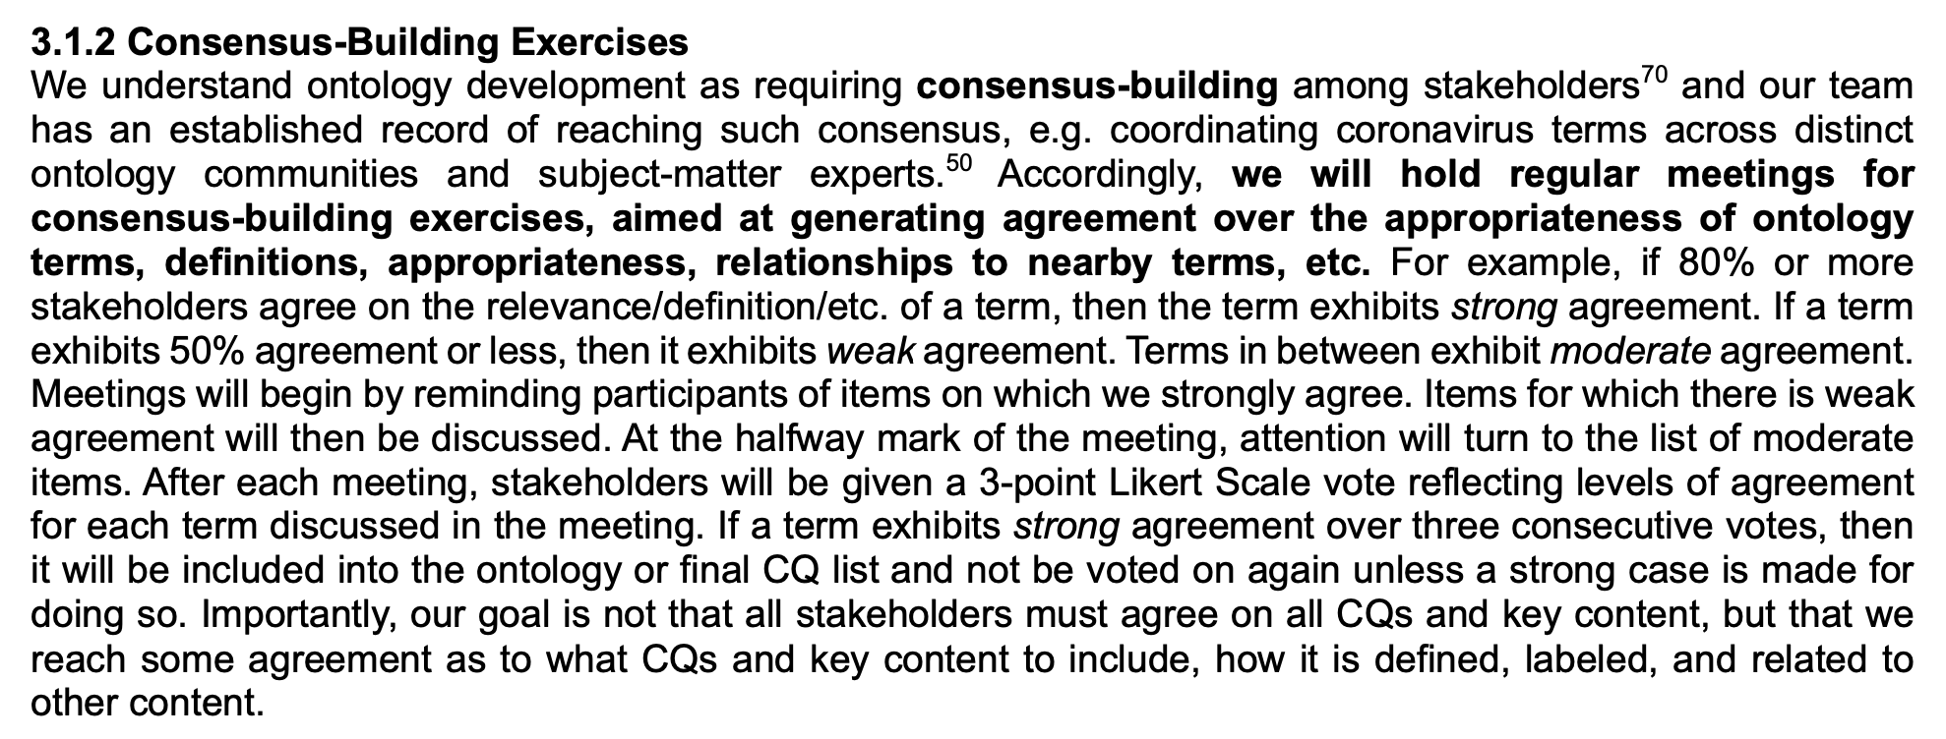
Consensus-Building Exercises
Consensus-building exercises are where ontologists and domain experts work towards an agreed understanding of ontology terms, definitions, etc.
Importantly, whatever agreement is reached is meant to be added to the ontology; domain experts can continue speaking as they need

Slide 11
Outline
Design Patterns Guidance
Mermaid
Guardrails
Complex vs Simplified Design Patterns

Slide 12
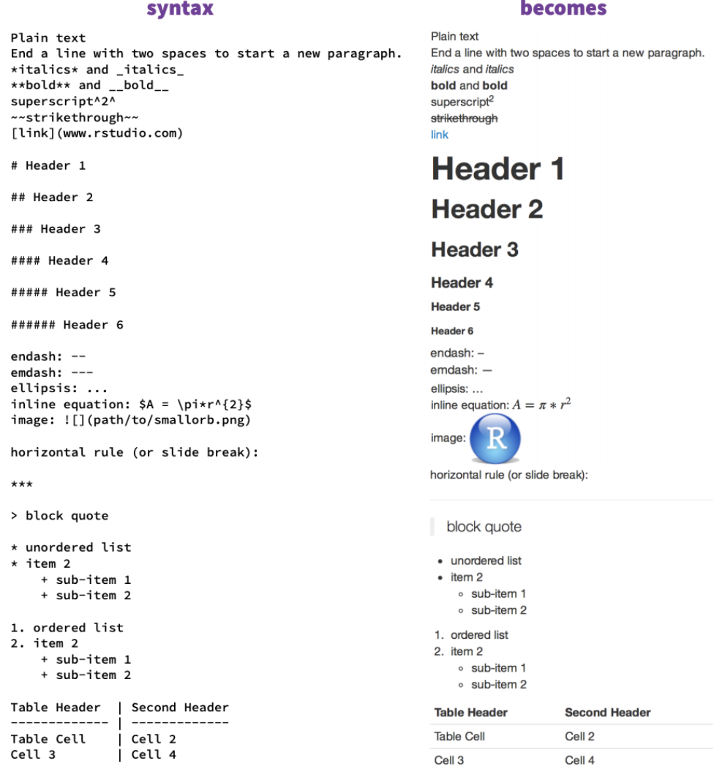

Markdown
Markdown is a popular markup language (that is, a text encoding system, such as HTML)
You’ll be using markdown in GitHub to format issues, posts, responses, etc.

Slide 13
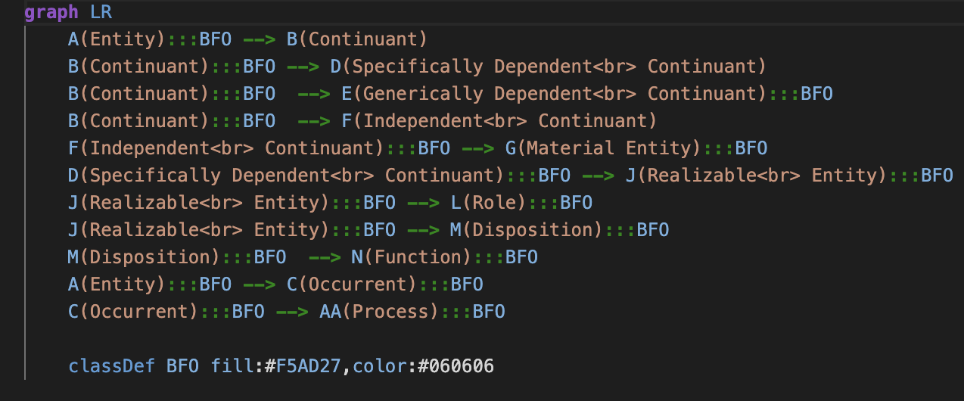
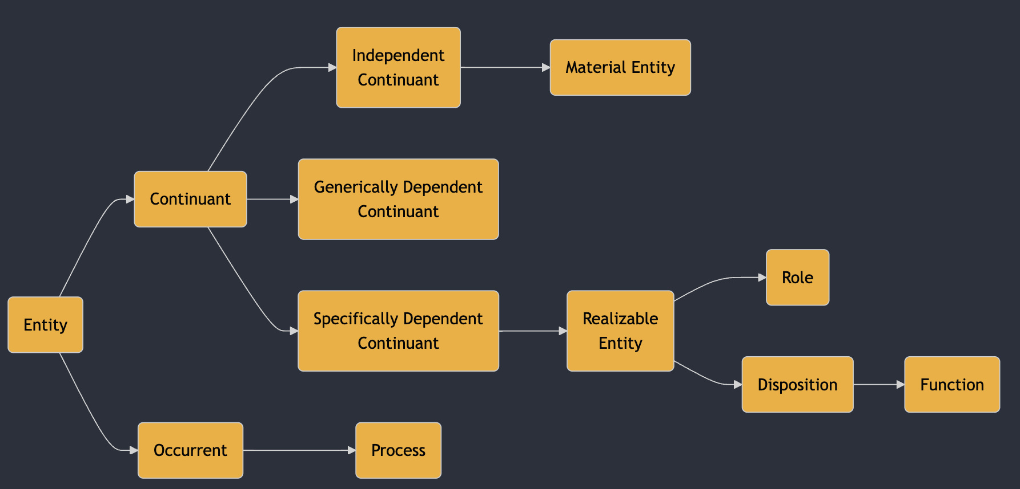

Mermaid
Mermaid is a flavor of Markdown specialized for representing diagrams
You’ll be using mermaid to represent design patterns in this course

Slide 14
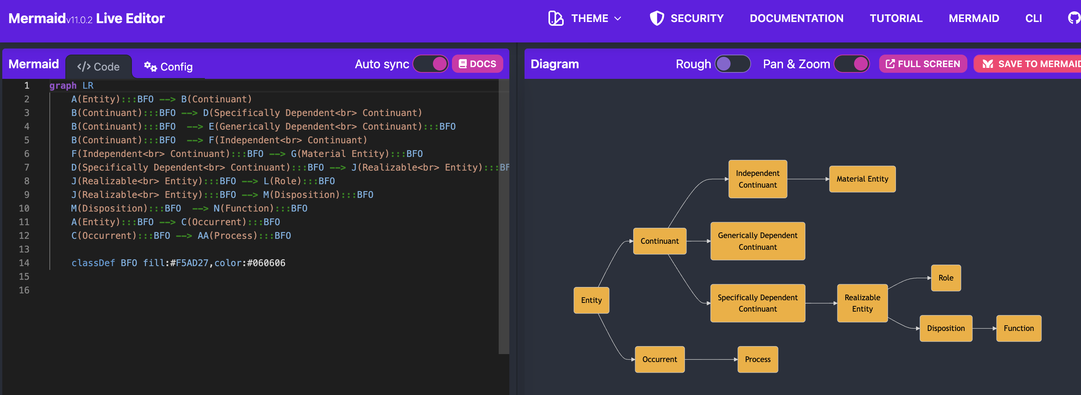
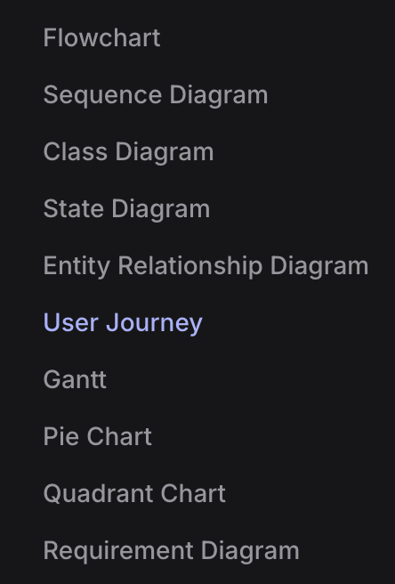
Play around in the live editor: https://mermaid.live/edit
Navigate to the helpful tutorials: https://mermaid.js.org/ecosystem/tutorials.html

Slide 15
Outline
Design Patterns Guidance
Mermaid
Guardrails
Complex vs Simplified Design Patterns

Slide 16
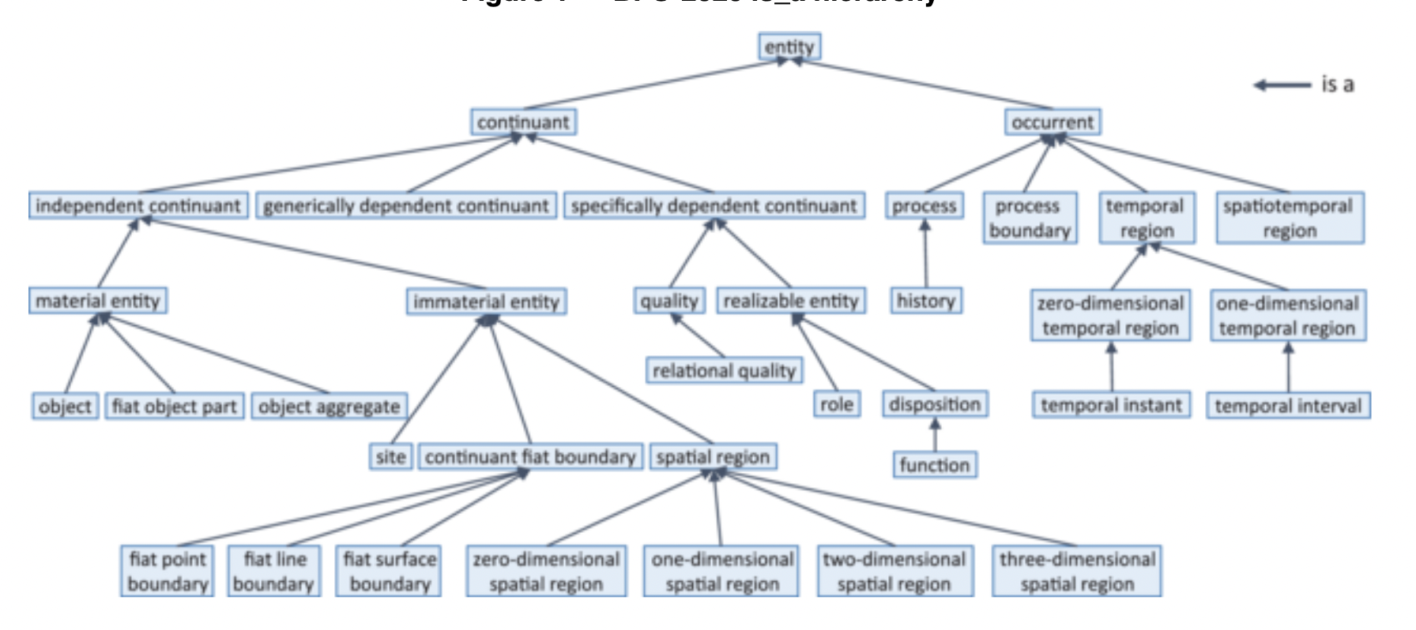

Slide 19
Eleatic Principle
The scope of BFO is space, time, and anything in space and time
As a litmus test, anything in space and time must have some causal impact on other entities in space and time
Material entities are paradigmatically in space
Nearly everything in BFO traces its dependence back to material entities

Slide 21
Eleatic Principle
Generically dependent continuants are concretized in specifically dependent continuants
Processes realize certain specifically dependent continuants
Specifically dependent continuants are borne by independent continuants, such as material entities

Slide 22
Rules of Thumb
When building a design pattern, describe:
Material entities within scope, i.e. Material Entity
Qualities these material entities have, i.e. Quality
What these material entities can do, i.e. Process
What properties underwrite what they can do, i.e. Realizable Entity
Where these material entities and their boundaries are located, e.g. Immaterial Entity
When these entities exist, e.g. Temporal Region
Information we use to talk about 1-6, i.e. Generically Depedent Continuant

Slide 23
Exercise
Suppose you’ve been given the following competency question to answer:
How quickly are shipping containers transported by Wal-Mart’s truck fleet over a given fiscal quarter?
Leveraging the BFO hierarchy, work in groups to provide a design pattern that aims to answer this question

Slide 24
Outline
Design Patterns Guidance
Mermaid
Guardrails
Complex vs Simplified Design Patterns

Slide 25
Complex vs Simplified
Ontology engineers must often work with developers who need to deploy our work
Developers do not always need the full ontology design patterns or ontologies that we create
We of course create full patterns where we can as a way to future-proof our projects
In the short-term however, we must be able to give developers what they need

Slide 26
Complex vs Simplified
Call the full pattern ontology engineers are trained to generate a Complex Design Pattern (CDPs)
Call sub-graphs of Complex Design patterns that aim to addressing specific user needs Simplified Design Patterns (SDPs)
Our task is to show how to construct SDPs from CDPs, so we maintain a connection from what developer’s need now to what they might need in the future

Slide 27
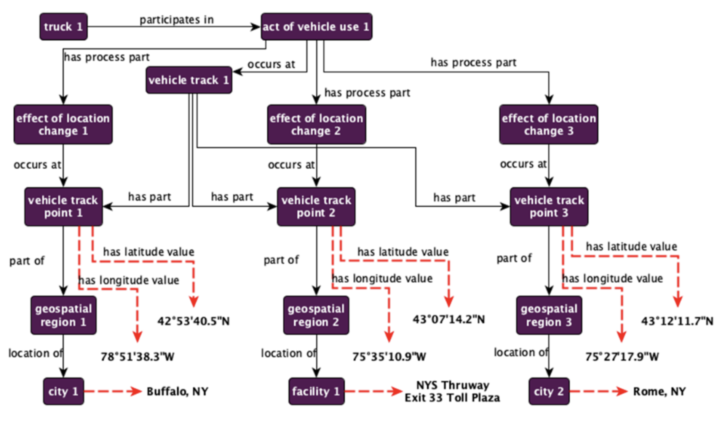
Represent the path taken by a ground vehicle over some geospatial region.

Slide 28
Developers may only need, for example, that a truck participates in an act of vehicle use

Slide 29
If so, then that is what you give them...
This is acceptable because – in the actual ontology artifact on a given computing system – we can cut this part of the graph from the larger graph represented in the preceding design pattern
The rest is simply adopting configuration management strategies to ensure you SPCs remain aligned with CDPs

Slide 30
Exercise
Suppose you’ve been given the following competency question to answer:
Are shipping containers transported by Wal-Mart’s truck fleet?
Leveraging the design pattern emerging from your previous exercise, extract a simplified design pattern that addresses this question

